Slide 1
Data stories

Slide 2
Phase 1
Housing during the Celtic Tiger: 1991-2006

Slide 3
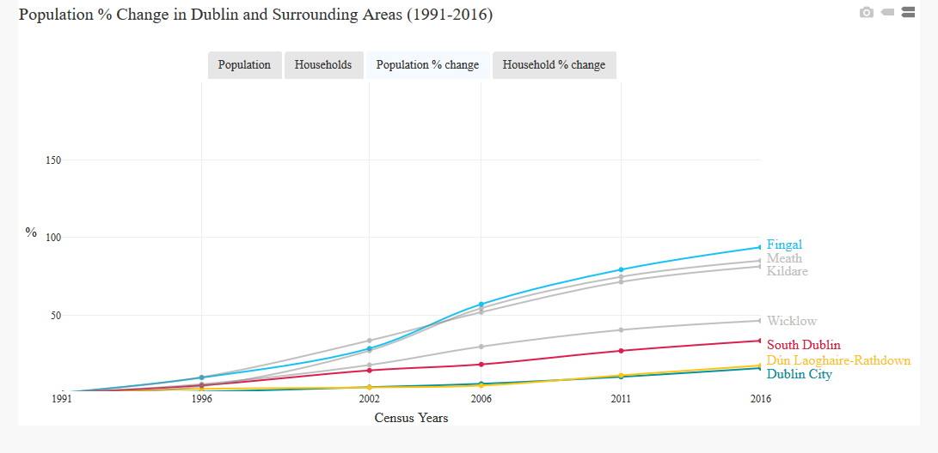
Population and households
Between April 1991 and April 2006 the population of Ireland increased by 704,129 (20%), the number of households by 440,437 (43%). The four Dublin Local Authorities, and the three surrounding counties of Kildare, Meath and Wicklow, all showed increases in population and number of households. In the case of Fingal, Kildare and Meath population increased by over 80% and households by over 120%.

Slide 4
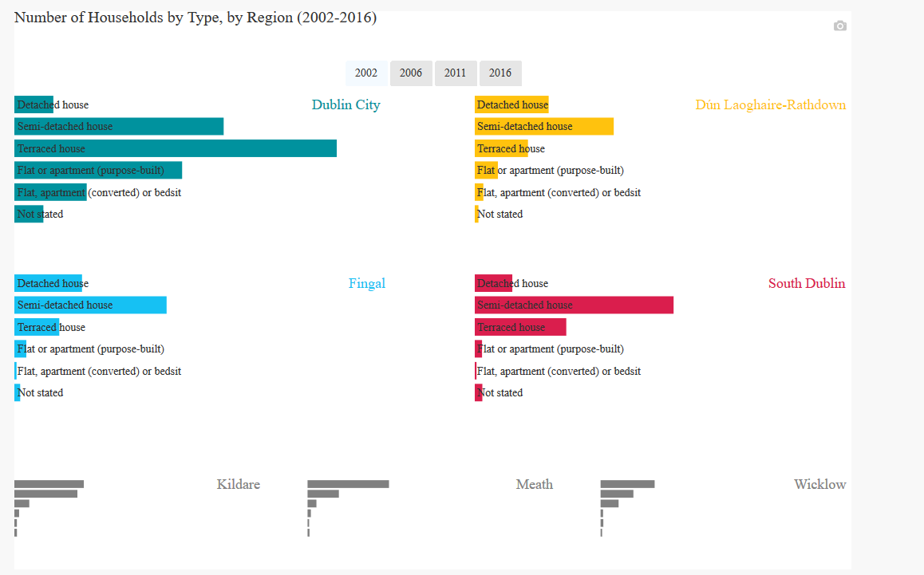
Demand for housing
Growth in population and households meant strong demand for housing, and a need to produce a more diversified housing stock that would cater for households of various types and sizes.

Slide 5
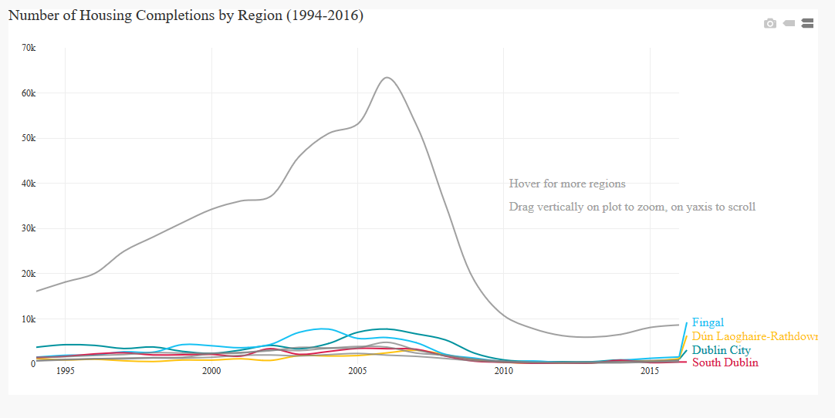
Housing completions
Between January 1991 and December 2006, 762,631 housing units were completed in Ireland, peaking with 93,419 units being built in 2006 alone. Between 1994 and 2006, 154,803 housing units were built in the four Dublin authorities and 84,688 three surrounding counties. Nationally, more units were being built than there were households being formed, especially in the period 2002-2006 (296,000 units built vs 181,563 households).

Slide 6
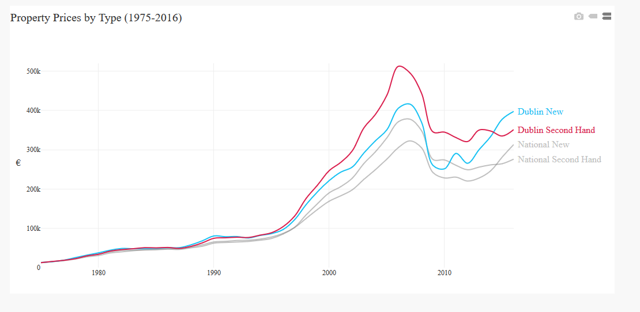
House prices
Despite housing completions running ahead of household growth, house prices grew dramatically. The average new house price rose from €78,715 in Dublin and €66,914 for the country as a whole in 1991, to €416,225 in Dublin (a 429% increase) and €322,634 for the country as a whole (a 382% increase) in 2007. Secondhand homes followed the same trend, with homes in Dublin rising by 551% and 489% outside the capital. Wages did not increase by the same rate. In the 1995, the average secondhand house price was 4.1 times the average industrial wage. By 2007 house prices were 11.9 times the average industrial wage.

Slide 7
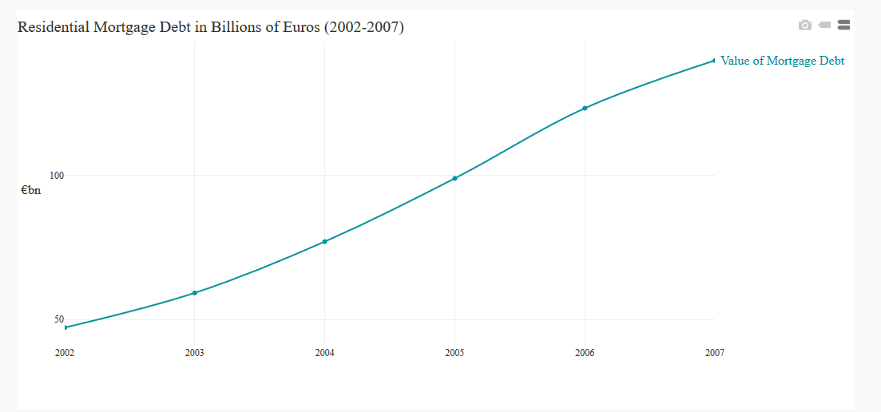
Mortgage debt
The rapid rise in house prices meant that the total value of household mortgage debt increased dramatically, from €47.2 billion in 2002 to over €139.8 billion at the end of 2007, with the average size of a new mortgage (€266,000) being nearly double the 2002 figure.

Slide 8
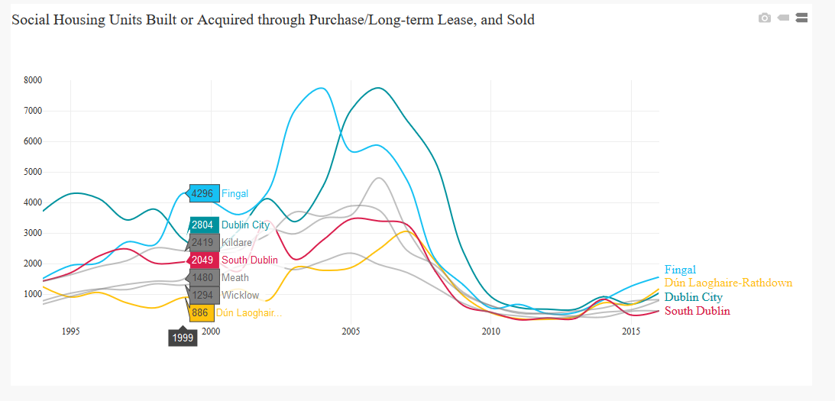
Social housing
State investment in social housing was waning whilst demand was growing, with a turn to the private sector to provide accommodation through a rent supplement scheme. Between 1994 and 2007 47,769 social housing units were built in Ireland, plus between 1999 and 2007 9,378 were acquired through purchase and 1,201 long-term leases acquired through the Rental Accommodation Scheme. At the same time, 22,633 local authority units were sold to tenants. Some social housing built during the 1950s came to the end of its life needing either substantial refurbishment or replacement.

Slide 9
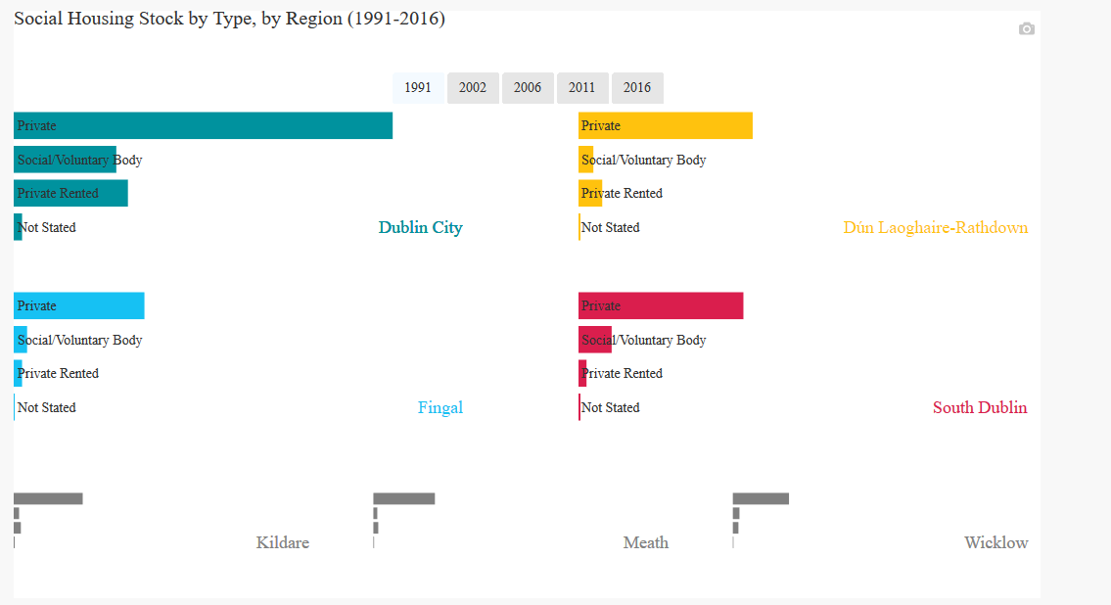
Housing tenure
As property prices grew and social house building waned, the nature of housing tenure started to change with a relative shrinking of owner-occupiers and social housing and a growth in private rented accommodation.
Need this graph to also have relative share of housing tenure.
Need to make clear private means privately owned.

Slide 10
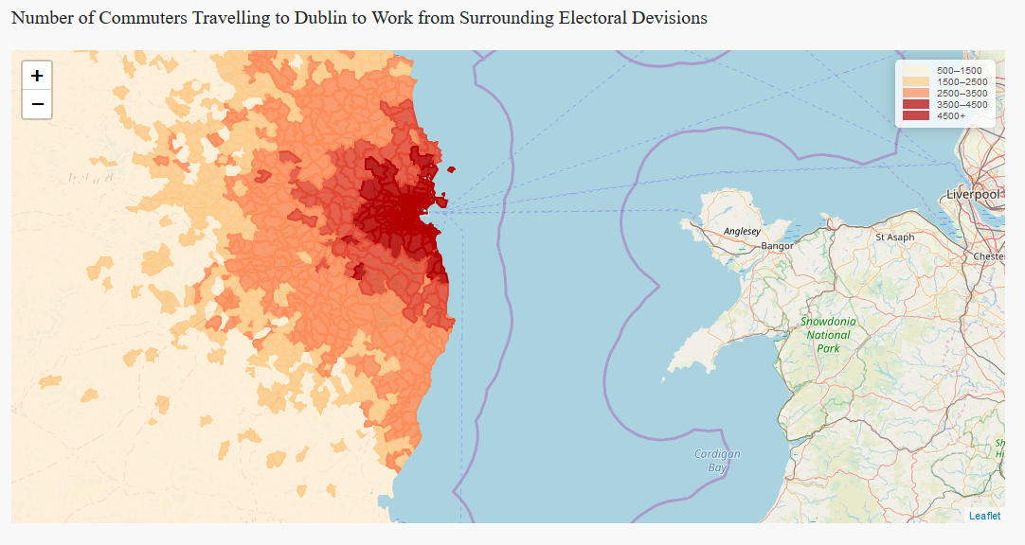
Urban sprawl and long distance commuting
Given the cost of housing, households who wished to buy a home but who had limited resources were forced to either buy property that did not suit their future needs with the aim of trading up later, borrowing beyond their means, or buying in an area further away and commuting, leading to extensive urban sprawl and the growth of smaller towns around the principal cities and towns.

Slide 11
Phase 2
Housing during the Crisis: 2007-2013

Slide 12
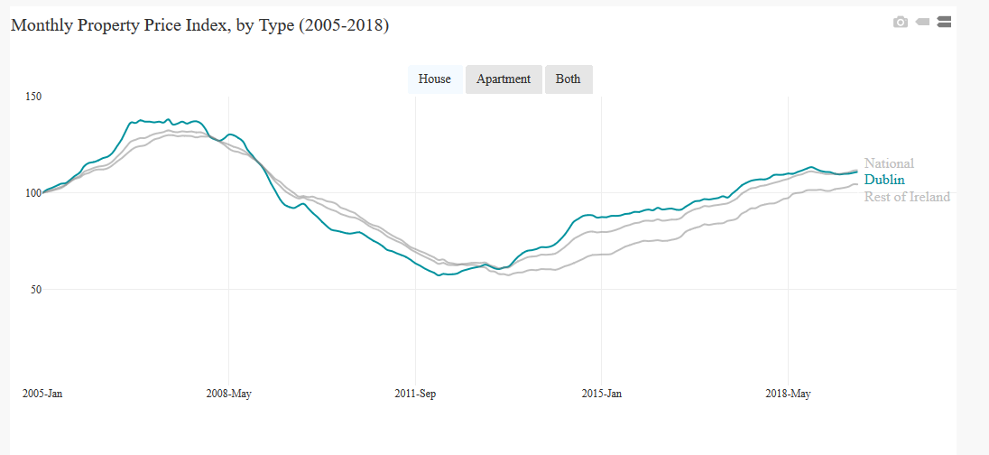
House prices
As the global economy slowed and the global sub-prime banking crisis began, house price rises in Ireland started to slow in September 2006, levelled-off in March 2007, and remained static until November 2007. From December 2007 to February 2012 they fell consistently before bottoming-out and remaining stable until June 2013. From the peak to bottom, prices fell by 57.4% in Dublin (houses 55.9% and apartments 63.7%) and 48.7% in the rest of the country. Ireland experienced one of the deepest house market collapses on record.

Slide 13
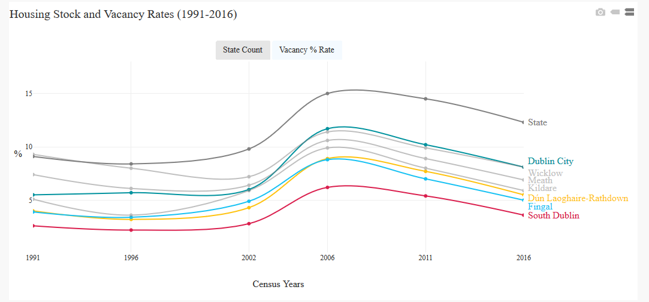
Vacant housing
Between 2005 and 2007 there were 252,403 housing units completed in Ireland, with another 78,144 added in 2008 and 2009 as legacy construction slowed. This is despite the fact that the 2002 census had reported 143,418 vacant units and that, by the following census of 2006, that figure had grown to 266,322 vacant units. Put simply, housing units had been built in excess of demand across the entire country, with a vacancy rate for the state (excluding holiday homes) of 15%. Oversupply was approximately 110,000 units.
Add 7 LA counts. Need to differentiate vacant and holiday homes in counts. Need to say vacancy rate excludes HHs.

Slide 14
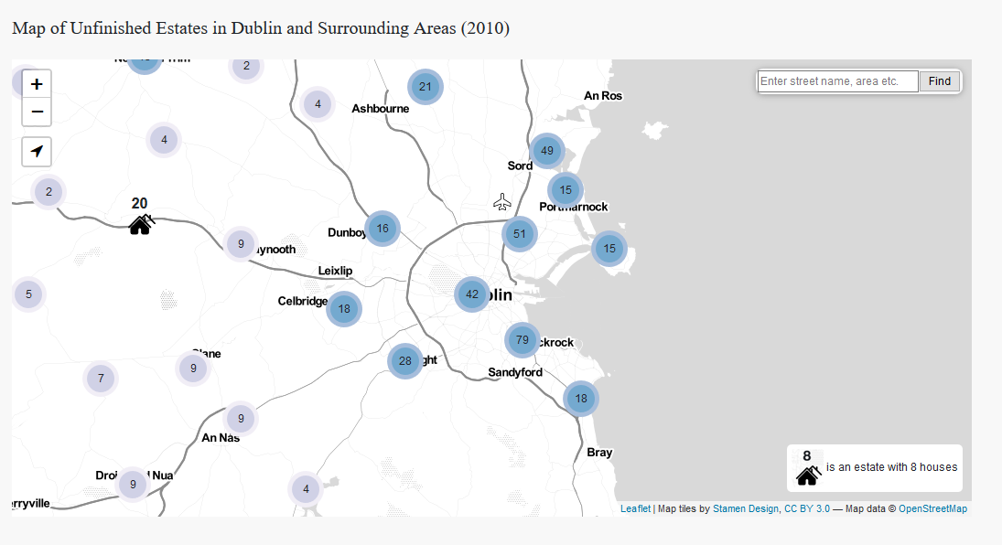
Unfinished estates
The most visible manifestation of the oversupply issue was unfinished housing estates. The National Survey of Housing Developments reported that there were 2,846 documented unfinished estates in Ireland in 2010, present in every local authority. With respect to the units on these estates, 78,195 were complete and occupied, 23,250 complete and vacant, and 19,830 under construction, with planning permission in place for a further 58,025 units.

Slide 15
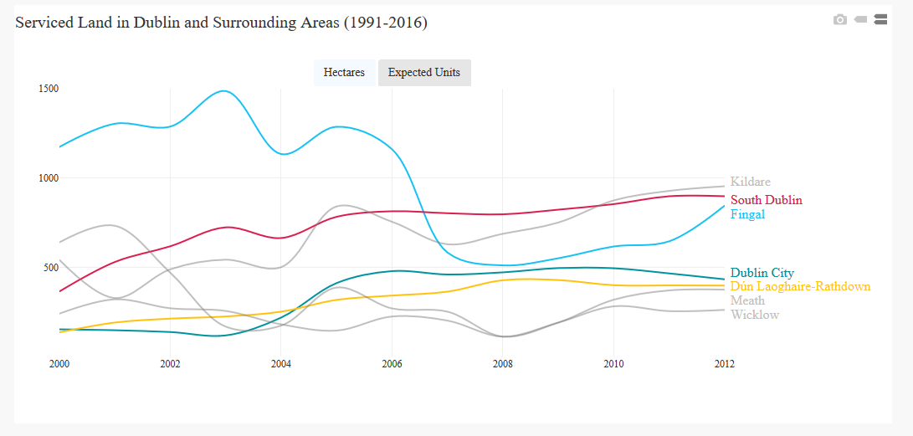
Oversupply of zoned land and commercial premises
In addition to the oversupply of dwellings, there was also an oversupply of zoned land and commercial premises. In June 2008, there was 14,191 hectares of serviced zoned land in the state, enough for up to 462,000 potential new units. In Dublin, some 782,500m2 of office space (23%) was vacant in 2010. Not unsurprisingly, land prices plummeted by between 75-98% in value post-2007.

Slide 16
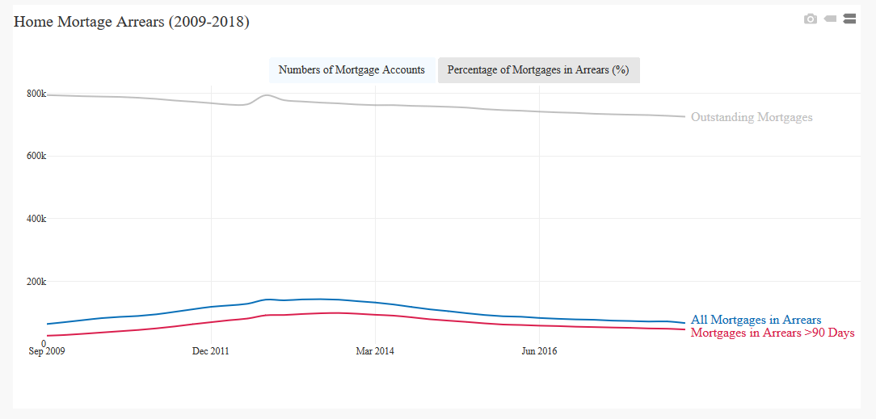
Household mortgage arrears
Faced with paying high payment rates on their mortgages, many households struggled to keep up with payments. In Q3 2009 3.3% of principal residence mortgages (26,700 mortgages) were in arrears by more than 90 days. By Q3 2013 this had peaked at 12.9% (98,763 mortgages), with 18.4% in some level of arrears (141,269 mortgages).

Slide 17
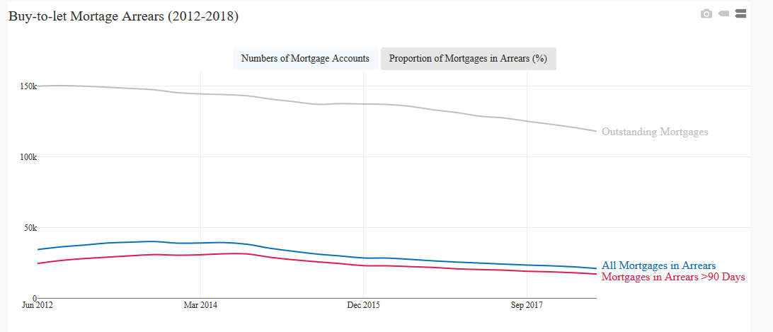
Buy-to-let mortgages
With respect to buy-to-let mortgages, 21.2% (31,178) were in arrears of more than 90 days, with 27.4% (40,426) in some level of arrears in Q3 2013.

Slide 18
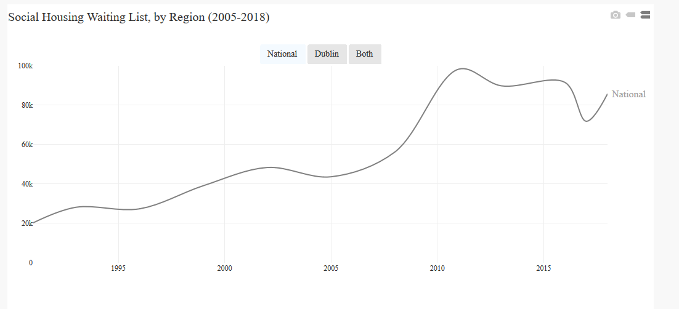
Social housing waiting list
The huge house price rises in the Celtic Tiger years, followed by the financial pressures of the crash, had significant spillover effects with respect to social housing demands and homelessness. In 1999 there were 39,176 households on the social housing waiting list, rising to 98,318 in 2011. The vast majority of people on this list are there because they cannot afford private rental accommodation, or to purchase a home of their own.

Slide 19
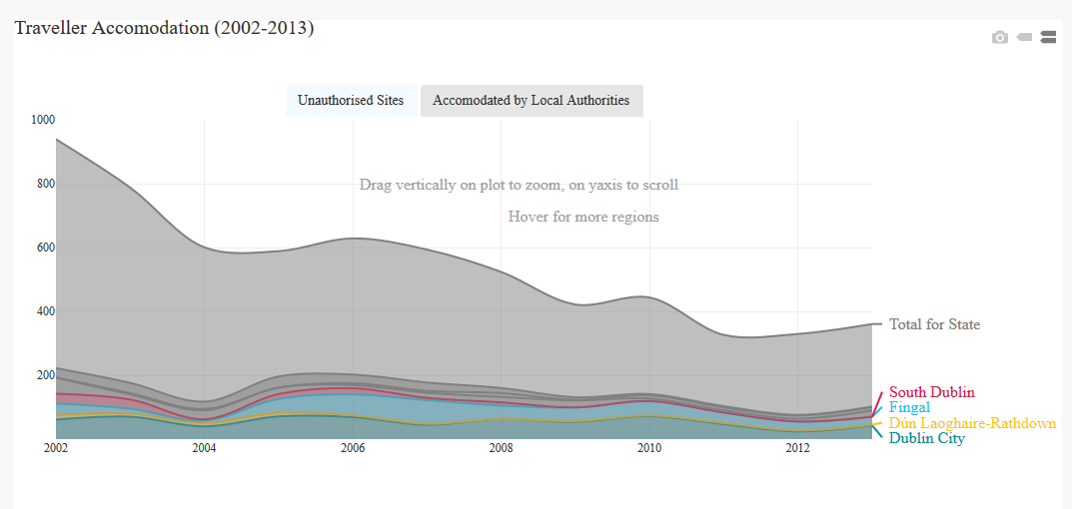
Traveller accommodation
During the crisis, planned investment in Traveller accommodation nationally also stalled during this period. In 2013, there were 361 Traveller families living on unauthorised sites, and 5574 in various types of local authority housing.

Slide 20
Phase 3
Housing post-crisis: 2013 -

Slide 21
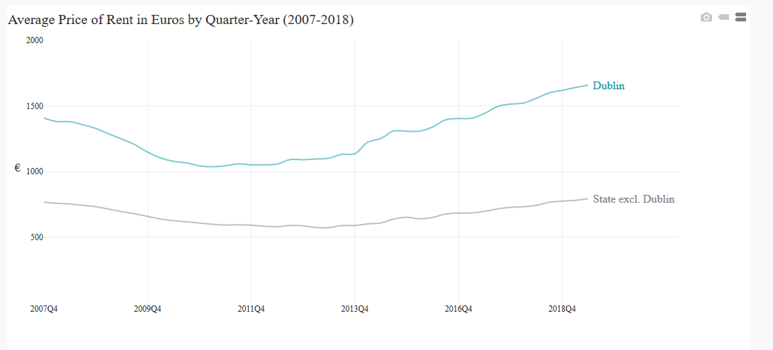
Rent prices
The effect of very little new housing supply for either purchase or rent, but rising demand, has led to the inflation of rent prices, increasing by 60.1% between 2010 and 2019. House purchase prices are being suppressed by Central Bank rules on deposits.

Slide 22
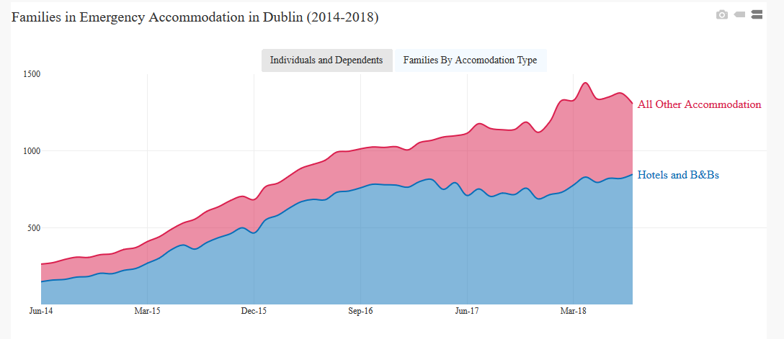
Homelessness
One the effects of rent increases is that families who are income insecure cannot afford rent increases, and with no social housing available these families find themselves homeless. The Dublin Region Homeless Executive (DRHE) detail that in June 2014, 913 adults and dependents were in emergency accommodation. By Nov 2018, this has risen to 4,635. Of these, 848 families are living in hotels and B&Bs, and 459 in other provided accommodation.

